Slide 1
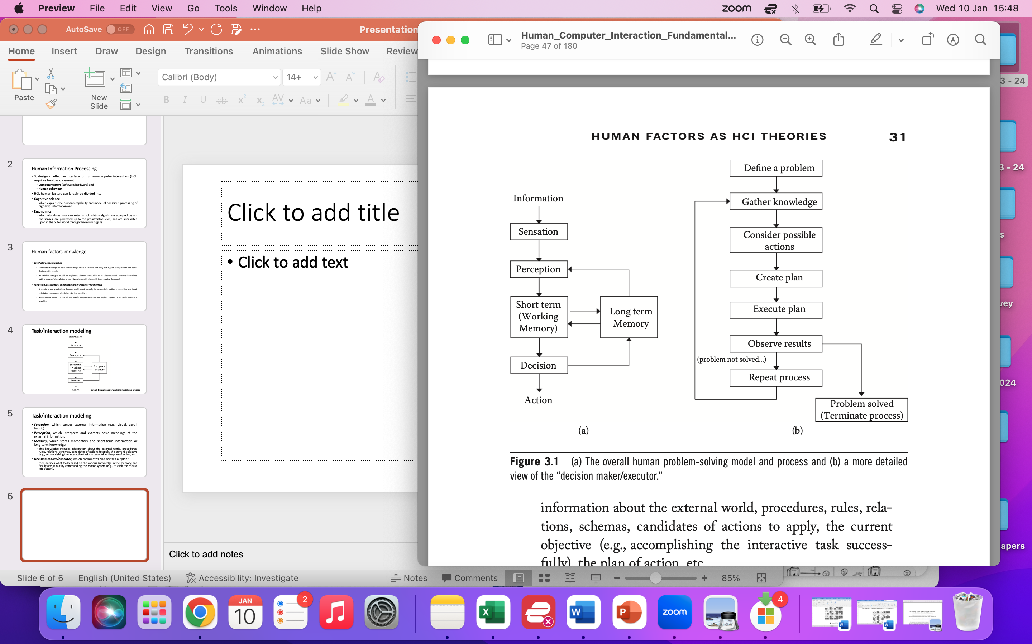
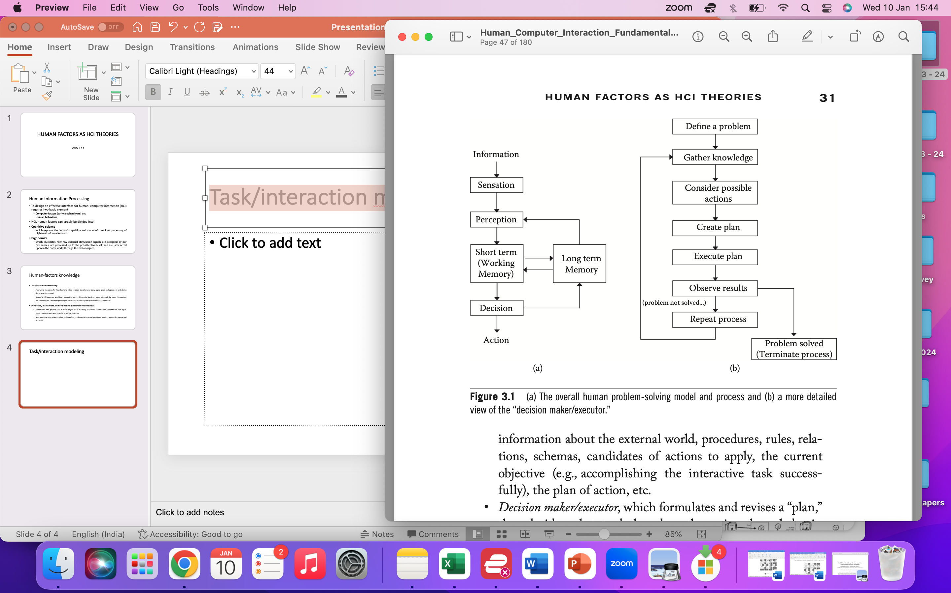
Task/interaction modeling
Sensation, senses external information (e.g., visual, aural, haptic)
Perception, interprets and extracts basic meanings of the external information.
Memory, which stores momentary and short-term information or long-term knowledge.
Decision maker/executor, decides what to do based on the various knowledge in the memory, and finally acts it out by commanding the motor system

Slide 2
GOMS : analyze the cognitive processes involved in completing a task
Goals: a task is broken down into specific goals that the user aims to achieve.
Operators: actions that users perform to achieve a goal and in task execution.
Methods: step-by-step actions users take to move from one state to another; to accomplish a sub-goal or task
Selection rules: decision-making processes based on the user's state, goals, and the environment.

Slide 3
2.1 Visual
Field of view (FOV): This is the angle subtended by the visible area by the human user in the horizontal or vertical direction.
Display field of view: This is the angle subtended by the display area from a particular viewing distance.
Viewing distance: This the perpendicular distance to the surface of the display.
Display resolution: This is the number of pixels in the horizontal and vertical directions for a fixed area.
Visual acuity: the resolution perceivable by the human eye from a fixed distance. This depends on the power of sight, which is different for different people and age groups.
Color: A color can be specified by the composure of the amounts contributed by the three fundamental colors and also by hue (particular wavelength), saturation (relative difference in the major wavelength and the rest in the light), and bright- ness value (amount of light energy emitted by the object)
Contrast: Relative difference in brightness or color between two visual objects.
Practical Implication- color coding information on a map/weather

Slide 4
Aural Feedback Types: refers to the use of sound or auditory cues as a means of providing information or interaction feedback in various contexts.
Omnidirectional Perception: Aural feedback can be perceived from all directions, making it effective for attracting attention and guiding users in a wide range of environments. Example: Public Announcement System
Attention Grabber and Director: Sound is often employed to capture and direct a user's attention, signaling important events or changes in a system. Example: Smartphone Notification Sound, Emergency Alert System
Frequency Components: Differentiated frequency components in sound can be utilized to convey specific types of information. Example: Car Backup Sensors
Habituation and Continuous Sound: Continuous or repetitive sounds may lead to habituation. Example: Elevator Background Music
Selective Listening: While challenging, users have the ability to selectively focus on specific elements of aural feedback, requiring concentration and effort to tune into particular sounds. Example: Symphony Orchestra Performance

Slide 5
Aural Modality as Input Method
Isolated-Word-Recognition Technology:
Technology for recognizing isolated words, suitable for simple commands, has become robust.
Often requires speaker-specific training or a relatively quiet background.
A challenge in voice input is the "segmentation" problem, determining the portion of continuous voice input or background noise that corresponds to the actual command.
Explicit Mode for Voice Input:
Many voice input systems operate in an explicit mode where the user needs to press a button to activate voice recognition.
This helps in avoiding the computational burden of running voice recognition continuously in the background.
Switching to the voice-command mode can be a nuisance for ordinary users.
Voice input is more effective when hands are occupied or in situations with minimal background noise, where modes are not necessary.

Slide 6
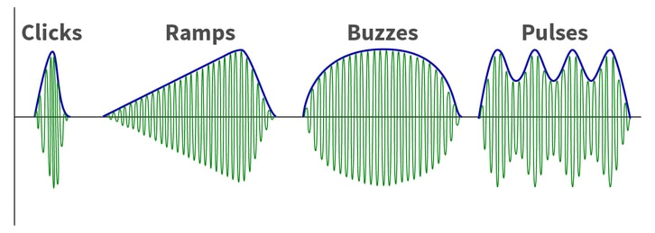
Tactile Display Parameters
Tactile resolution: the skin sensitivity to physical objects is different over the human body.
Vibration frequency:
Pressure threshold: when the force/torque gets large enough, the kinesthetic senses start to operate, and this threshold will greatly depend on the physical condition of the user (e.g., strong vs. weak user).

Slide 7
Haptic and Haptic Display Parameters
Actuation Mechanism: The method by which haptic feedback is generated, including mechanisms like vibrotactile actuators, piezoelectric elements, electrostatic forces, and pneumatic systems.
Force Feedback: The force applied by the haptic device in response to user interactions. It can range from gentle vibrations to more substantial forces simulating resistance or pressure.
Vibration Patterns: The specific patterns of vibrations used to convey different tactile sensations.
Texture Rendering: The ability of the haptic system to simulate textures by varying the surface properties perceived by the user.
Dynamic Range: The range of forces or pressures that the haptic system can reproduce.

Slide 8
Haptic and Haptic Display Parameters
Resolution: The density of tactile elements or actuators per unit area, determining the detail and precision of haptic feedback.
Spatial Accuracy: The precision with which a haptic display can reproduce spatial details, contributing to the fidelity of the tactile experience.
Frequency Response: The range of frequencies or vibration patterns that a haptic display can produce, influencing the diversity of tactile sensations it can simulate.
Latency: The delay between a user's input and the corresponding haptic feedback. Low latency is essential for providing a responsive and immersive user experience.
Shape Variation: Some haptic displays can dynamically change the shape or contour of individual tactile elements, contributing to the simulation of shapes and surfaces.
Degrees of Freedom - the number of directions in which force or torque be can displayed
Force Range - should be at least greater than 0.5mN
Operating/Interaction Range - how much movement is allowed through the device
Stability - how stable the supplied force is felt to be

Slide 9
Multimodal Interaction
Multimodal interaction refers to the use of multiple sensory modalities, such as sight, sound, touch, and gesture, simultaneously to enhance the overall user experience by leveraging the strengths of each modality.
Mimics the way humans naturally communicate and interact with the world, where information is often processed through multiple senses simultaneously.
Complementary - Different modalities can assume different roles and act in a complementary fashion to achieve specific interaction objectives. For example, an aural feedback can signify the arrival of a phone call while the visual displays the caller’s name.
Redundant - Different modality input methods or feedback can be used to ensure a reliable achievement of the interaction objective even if one modality is unclear . For instance, the ring of a phone call can be simultaneously aural and tactile to strengthen the pick-up probability.
Alternative - Providing users with alternative ways to interact gives people more choices. For instance, a phone call can be made either by touching a button or by speaking the callee’s name, thereby promoting convenience and usability.

Slide 10
Key Aspects of Multimodal Interaction
Multimodal systems can adapt to user preferences, allowing individuals to choose the combination of modalities that best suits their needs and preferences.
Incorporates gestures as a mode of interaction, allowing users to convey commands or information through natural body movements.
Integrates voice and speech recognition for natural language input, enabling users to communicate with systems through spoken commands or queries.
Utilizes haptic feedback to provide a tactile dimension to interaction. For example, touchscreens with haptic feedback can simulate the sensation of pressing physical buttons.
Involves tracking the movement of the user's eyes to understand their focus of attention, enabling more context-aware and responsive interactions.
Multimodal systems can leverage context information, such as the user's location, environment, and activity, to tailor the interaction dynamically.

Slide 11
Human Body Ergonomics
Human body ergonomics is a crucial aspect of HCI, as it involves designing computer systems and interfaces that accommodate and enhance the natural capabilities and limitations of the human body.
Focus on the human motor capabilities that are used to make input interaction:
Fitts Law
Human Motor Control

Slide 12
Fitts’s Law
Fitts's Law is a mathematical model that predicts the time it takes to move from one location to another in a user interface, based on the distance to the target and the size of the target.
MT = a + b . log₂​(A/W ​+ 1) or MT = a + b . log₂​ (ID) where ID = (A/W ​+ 1)
MT is the movement time required to reach a target.
A is the distance from the starting point to the center of the target.
W is the width of the target.
a and b are empirically determined constants.
ID is Index of Difficulty
Practical Implications:
Target Size Matters: Larger targets are easier to select, so designers often increase the size of interactive elements (buttons, icons, etc.).
Cursor Movement: The law has implications for cursor movement on screens. Designers may consider placing important targets closer or making them larger to optimize user interactions.
Menu Design: Fitts's Law has influenced the design of menus and toolbars, with an emphasis on providing larger clickable areas to facilitate quicker and more accurate selections.

Slide 13
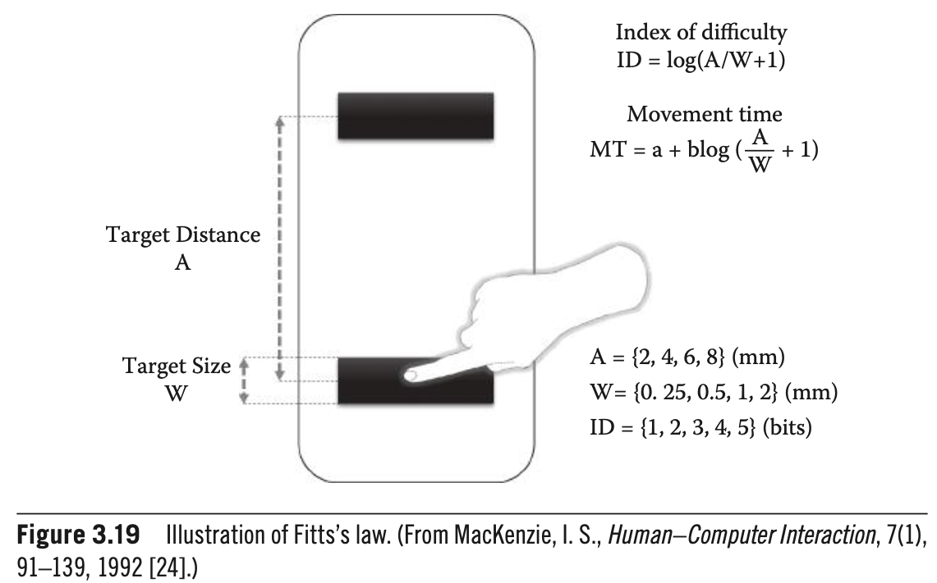

Slide 14
Motor control refers to the ability of the central nervous system (CNS) to regulate and coordinate the movements of the body's skeletal muscles. It involves the integration of sensory information, the planning and execution of movements, and the feedback mechanisms that allow for adjustments.
Motor Skills: gross motor skills (involving large muscle groups for activities like walking or running) and fine motor skills (involving precise movements of smaller muscle groups for tasks like writing or typing).
Sensory Input: Motor control relies on sensory information from the environment.
Motor Planning: The CNS processes sensory information to plan and organize movements. This involves decision-making about the sequence, force, and timing of muscle contractions needed to achieve a specific goal.
4.Execution of Movements: Once a movement plan is formulated, the CNS sends signals to the muscles through the motor neurons, leading to the contraction and relaxation of muscles to execute the desired movement.
5.Feedback Mechanisms: Motor control involves continuous feedback loops. Feedback informs the CNS about the ongoing state of the body, and sensory feedback from the environment helps adjust movements in response to changes.

Slide 15
Motor Control
1. Input Methods and Devices:
Most prevalent input involves movements of arms, hands, and fingers, such as keyboard and mouse input.
Continuous input methods in 2-D (e.g., mouse, touch screen) and 3-D (e.g., haptic, Wii-mote) spaces are common in modern user interfaces.
2. Control-Display (C/D) Ratio:
C/D ratio refers to the ratio of movement in the control device (e.g., mouse) to movement in the display (e.g., cursor). Low C/D ratio results in high sensitivity and fast travel time across the display
3. Challenge with Touch Interface:
Control accuracy for touch interfaces poses challenges due to the size of fingertip contact, particularly for small objects.
Even larger objects, once selected, may be challenging to control, especially when the touch screen is held by another hand or arm, introducing instability.

